Slide 1
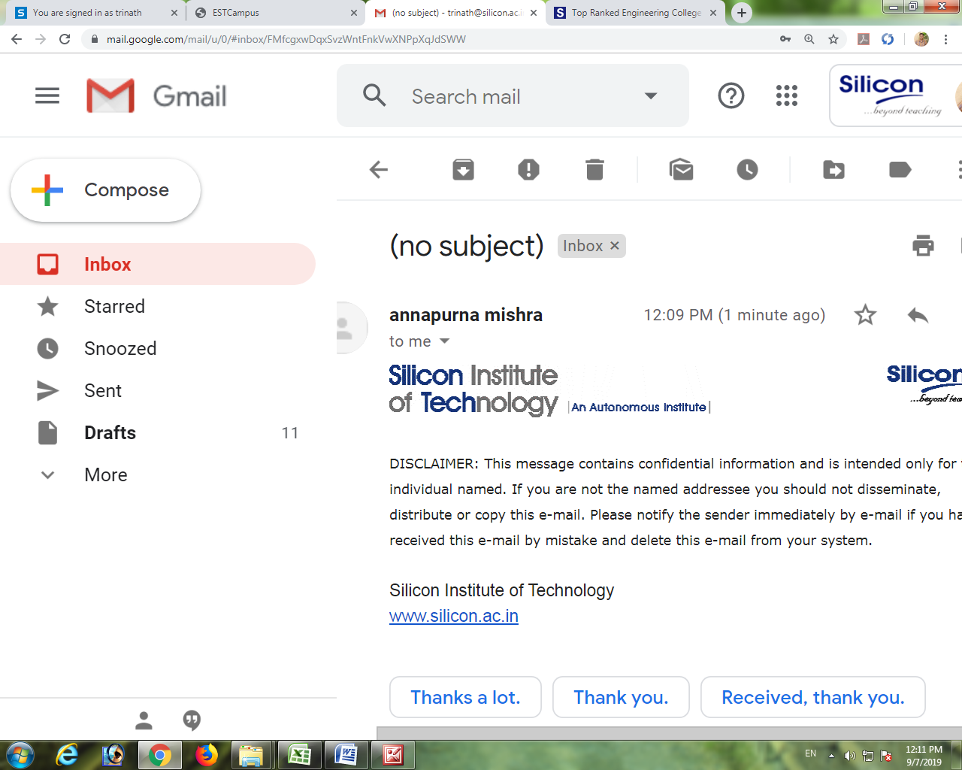
Department of
Computer Sc. & Engineering
Welcome to Final PS/II Project Presentation
SAP-ISU OVERVIEW
Submitted By
Sonali Pradhan (Regd. No. 2001209193)
Branch : Department of CSE
Mentors’ Name
Mrs. Sucharita Das
Director of Testing, PCON UTILITIES PVT. LTD
PS/II Supervisors’ Name
Mrs. Milan Samantaray
Professor, CSE

Slide 2

My Mentor
Mrs. Sucharita Das
Director Testing Services

Slide 3
Background of the Study
The motivation behind undertaking this project stems from the critical need for accurate meter reading and billing processes within utility companies.
By rectifying meter reading mistakes and ensuring precise billing, the project addresses the pain point of financial discrepancies and customer dissatisfaction resulting from inaccurate billing.
Through this research, a quantifiable improvement of 50-70% in billing accuracy was achieved, leading to reduced financial discrepancies and enhanced customer trust.
Objective
Our primary objective at PCON Utilities is to address Business Data Exception Management (BPEMs) by thoroughly analyzing customers' past consumption patterns.
By doing so, we aim to identify and rectify implausible meter readings, ensuring accurate billing for electricity usage.
As a Production Support Engineer, the primary goal is to ensure the accuracy and efficiency of SAP IS-U meter reading and invoicing processes for utility companies.

Slide 4
Problem Definition
Problem Statement
Our responsibilities include resolving implausible meter readings flagged by SAP, releasing erroneous data for correction, and ensuring accurate invoicing for utility customers.
This role involves meticulous analysis and collaboration to uphold data integrity and enhance customer satisfaction within the utility sector.
At PCON Utilities, we face the challenge of correcting unlikely meter readings flagged by our system, known as Business Data Exception Management (BPEM).
These anomalies, categorized into five types
MR01 – Consumption Below the Minimum Tolerance Limit
MR04 – Consumption Above the Maximum Tolerance Limit
MR06 – Zero Consumption with Demand
MR10 – Previous Implausible Exist
MR14 – Consumption on Inactive Meter

Slide 5
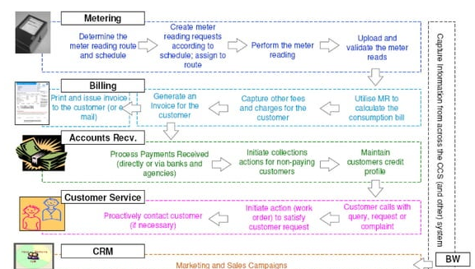
Work Flow Diagram
METER TO CASH FLOW

Slide 6
Method
Implausible meter readings must be released before …corrections can be made to ensure accurate billing.
Until implausibles are released, billing processes cannot …proceed, emphasizing the importance of this step.
Missing reads are manually added through estimation …using data from the most recent and oldest reads.
Different transaction codes (T-codes) are used for various …purposes:
EL27 for releasing reads
EL28 for adding reads
EL29 for correcting reads
EASIBI for billing the customer.
This approach ensures systematic handling of BPEMs and ….accurate billing for customers, utilizing specific T-codes for ….each step of the process.

Slide 7
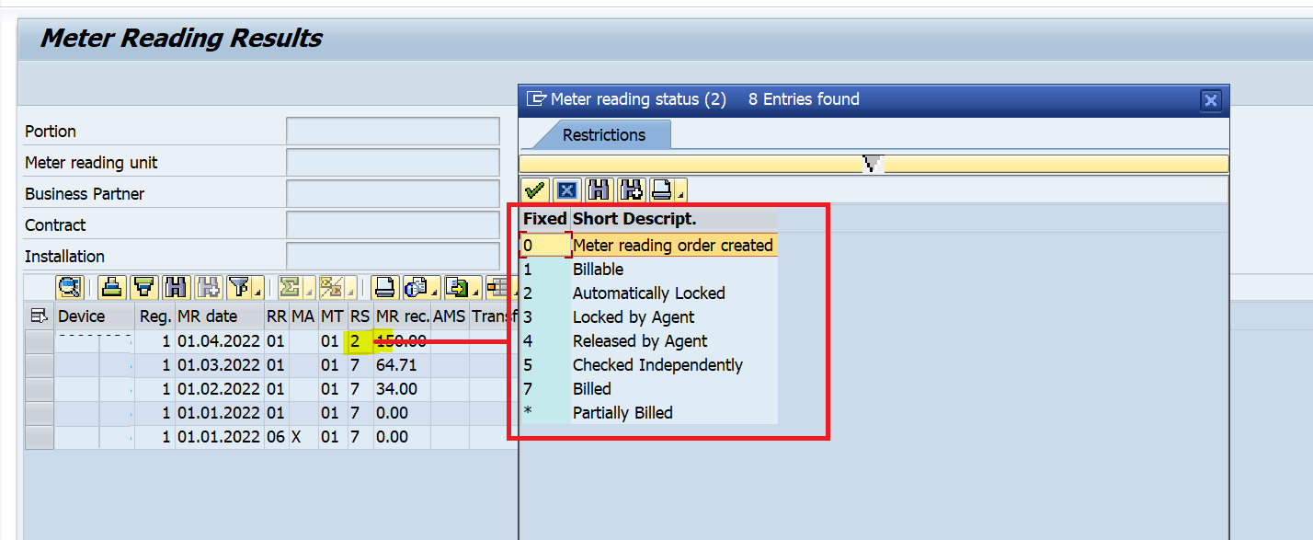
Results Obtained
IMPLAUSIBLE READS BEFORE CORRECTION
IMPLAUSIBLE READS AFTER CORRECTION
Here the meter reading status in the screenshot is 2 means it is in implausible state.
Then after releasing the reads the status becomes 4 which means it is plausible and ready for billing.

Slide 8
My Contribution
Developed a systematic approach to identify and resolve implausible meter readings.
Utilized cross-referencing techniques and historical data analysis for verifying readings.
Implemented procedures for releasing and estimating meter readings to ensure accuracy.
Leveraged SAP modules and Microsoft Excel for efficient data processing and analysis.
Enhanced overall operational efficiency by optimizing data management processes.
Contributed to precise billing and energy management through accurate meter reading data.

Slide 9
Conclusion and Future works
In conclusion, our project has demonstrated the transformative impact of automation in streamlining BPEM resolution processes within utility companies like PCON Utilities.
Despite encountering challenges such as initial setup costs and system compatibility issues, our achievements in reducing manual intervention by 30% underscore the significant benefits of adopting AI and ML technologies.
The Work Ahead
BILL REDESIGN AND MAPPING
EDM COMPLEX METERING
NEW APPLICATION TESTING
UTAH AND OHIO TESTING

Slide 10
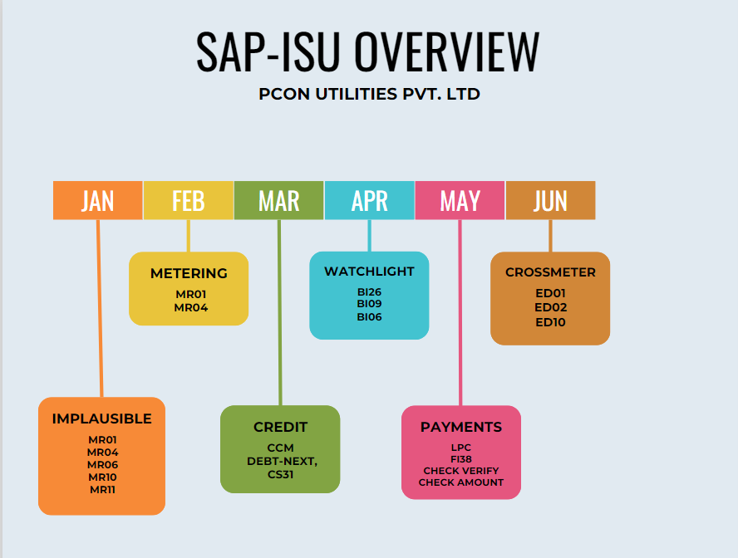
Project Timeline

Slide 11
References
SAP. (2022). SAP Integrated Business Planning. Retrieved from https://www.sap.com/products/integrated-business-planning.html
SAP. (2022). SAP S/4HANA. Retrieved from https://www.sap.com/products/s4hana-erp.html
SAP. (2022). SAP IS Utilities. Retrieved from https://www.sap.com/industries/utilities.html
SAP. (2022). SAP Community. Retrieved from https://community.sap.com/
SAP. (2022). SAP Help Portal. Retrieved from https://help.sap.com/home
References to be shown in IEEE Format

Slide 12





